Slide 2
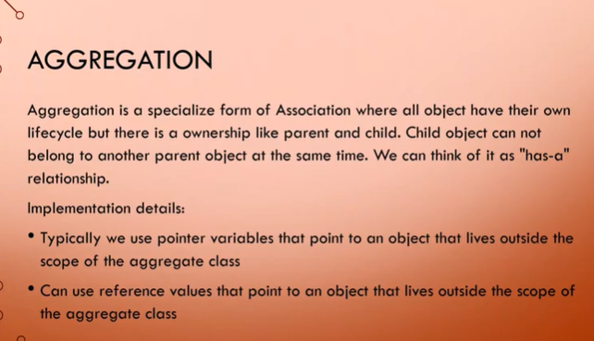

Slide 3
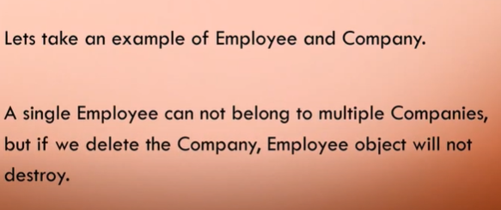

Slide 4
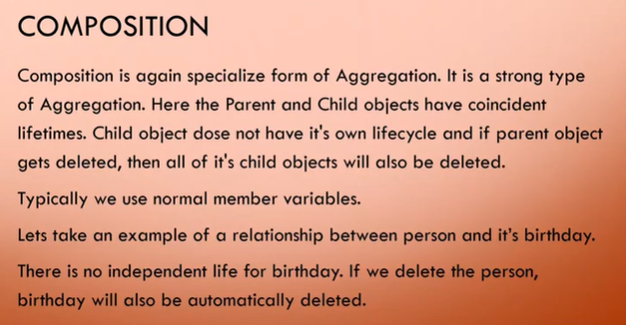

Slide 5
Qualified Association
It associates two objects using a qualifier to select object at the other end of association.
A qualifier is an attribute or set of attribute which has a unique value for each object in the class.
It is used to reduce multiplicity.

Slide 6
1 0…..*
Customer
order
Customer
1 1
order
Orderno

Slide 7
Properties of aggregation
Transitivity
IF A is a part of B, B is a part of C then A is a part of C.
E.g. If doors are part of rooms , rooms are part of house then doors are part of house.
Antisymmetry
If A is a part of B then B is not a part of A.
e.g. If kitchen is part of house then house is not a part of kitchen.

Slide 8
3. Propagation
The environment of part is same as that of the assembly.
e.g. if a car is in garage then steering wheel is unlikely to be somewhere else in the garage.

Slide 9
Types of aggregation
Fixed aggregation :-
The particular number and type of component parts are predefined.
e.g. Car has 1 engine, 1 steering wheel, 4 wheels etc.
Variable aggregation:-
The number of parts may vary.
e.g. coaches in a train.

Slide 10
3. Recursive aggregation :-
The object contains components of its own type.
e.g. Program contains loops and loop can again contains some loops.
program
loop

Slide 11
Delegation
Inheritance is the process by which one class takes the property of another other class. i.e. the new classes, known as derived or child class, take over the attributes and behavior of the pre-existing classes, which are referred to as base classes or super or parent class.
Delegation is simply passing a duty off to someone/something else.
Delegation can be an alternative to inheritance.
Delegation means that you use an object of another class as an instance variable, and forward messages to the instance.

Slide 12
It is better than inheritance for many cases because it makes you to think about each message you forward, because the instance is of a known class, rather than a new class, and because it doesn’t force you to accept all the methods of the super class: you can provide only the methods that really make sense .

Slide 13
Delegation can be viewed as a relationship between objects where one object forwards certain method calls to another object, called its delegate.
The primary advantage of delegation is run-time flexibility – the delegate can easily be changed at run-time. But unlike inheritance, delegation is not directly supported by most popular object-oriented languages, and it doesn’t facilitate dynamic polymorphism.

Slide 14
Program to illustrate Delegation
class RealPrinter
{
// the "delegate"
void print()
{
cout<<The Delegate";
}
} ;
class Printer
{
// the "delegator"
RealPrinter p ;
// create the delegate
void print()
{
p. print(); // delegation
}
} ;
// To the outside world it looks like Printer actually prints.
int main( )
{
Printer printer ;
printer. print();
}
}

Slide 15
Program to illustrate Inheritance
class RealPrinter {
// base class implements method
void print()
{
cout<<"Printing Data“;
}
} ; // Printer Inheriting functionality of real printer
class Printer :public RealPrinter
{
void print()
{
RealPrinter::print(); // inside calling method of parent
}
} ;
// To the outside world it looks like Printer actually prints.
int main( )
{
Printer printer ;
printer.print();
}

